Slide 1


PYTHON DATA ANALYSIS
Bike Data Analysis
Github ID: j245kim
Date: 11-07-2024

Slide 2
Index
C
Validate Inference
Using a heatmap and t-test to validate the inferences made from the graph and explore other correlations
A
First Step
D
ML
What I did when I first saw the data!
Machine learning process
B
Drawing the Graph
E
Conclusion
Visualization process
My thoughts and results

Slide 3
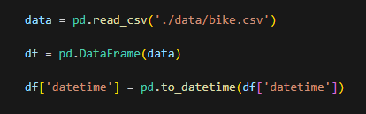

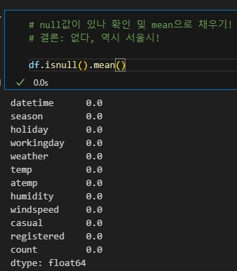
Step 1

Slide 4
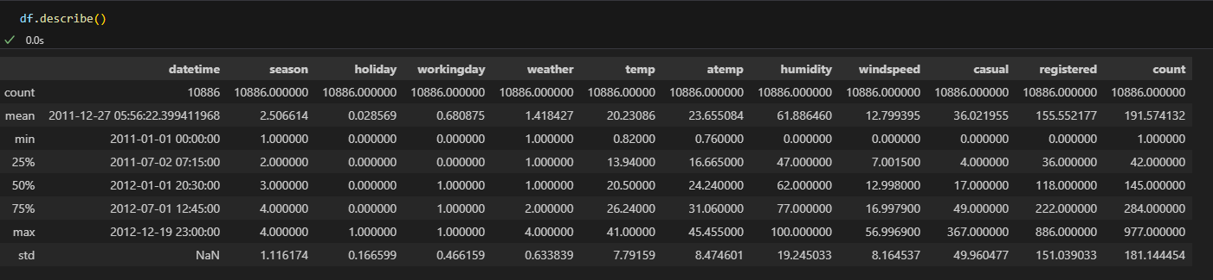
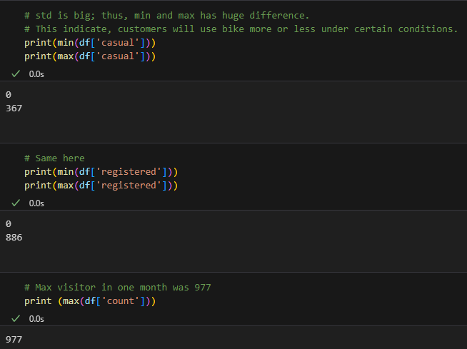


Rough Ideas

Slide 5
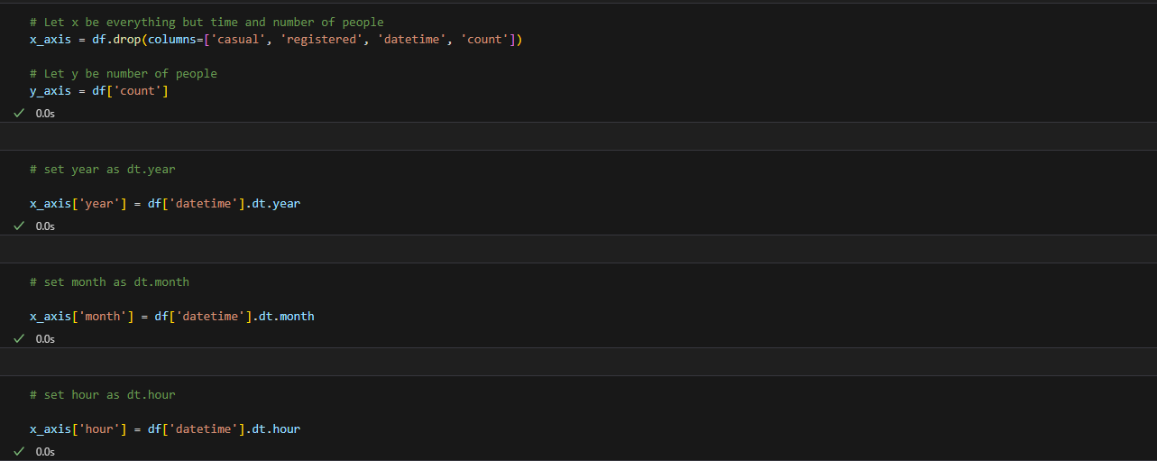
Step Before Drawing Graph

Slide 6

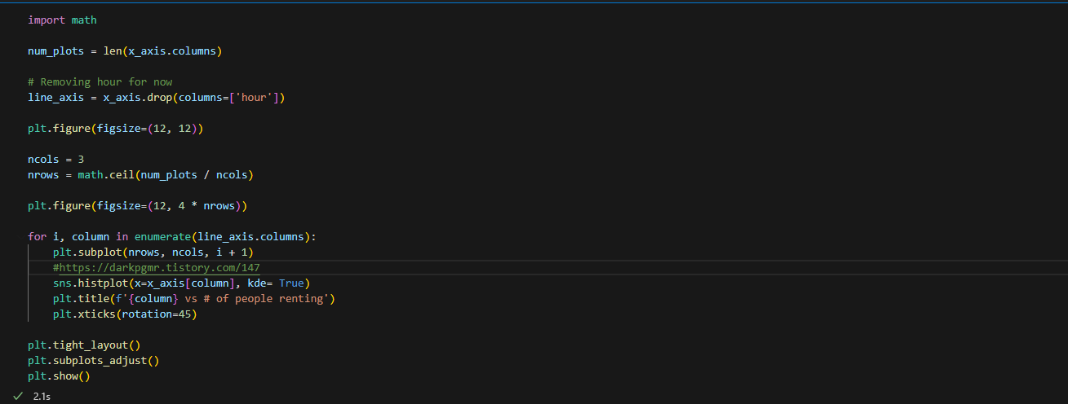
Step 2: Graph Code

Slide 7
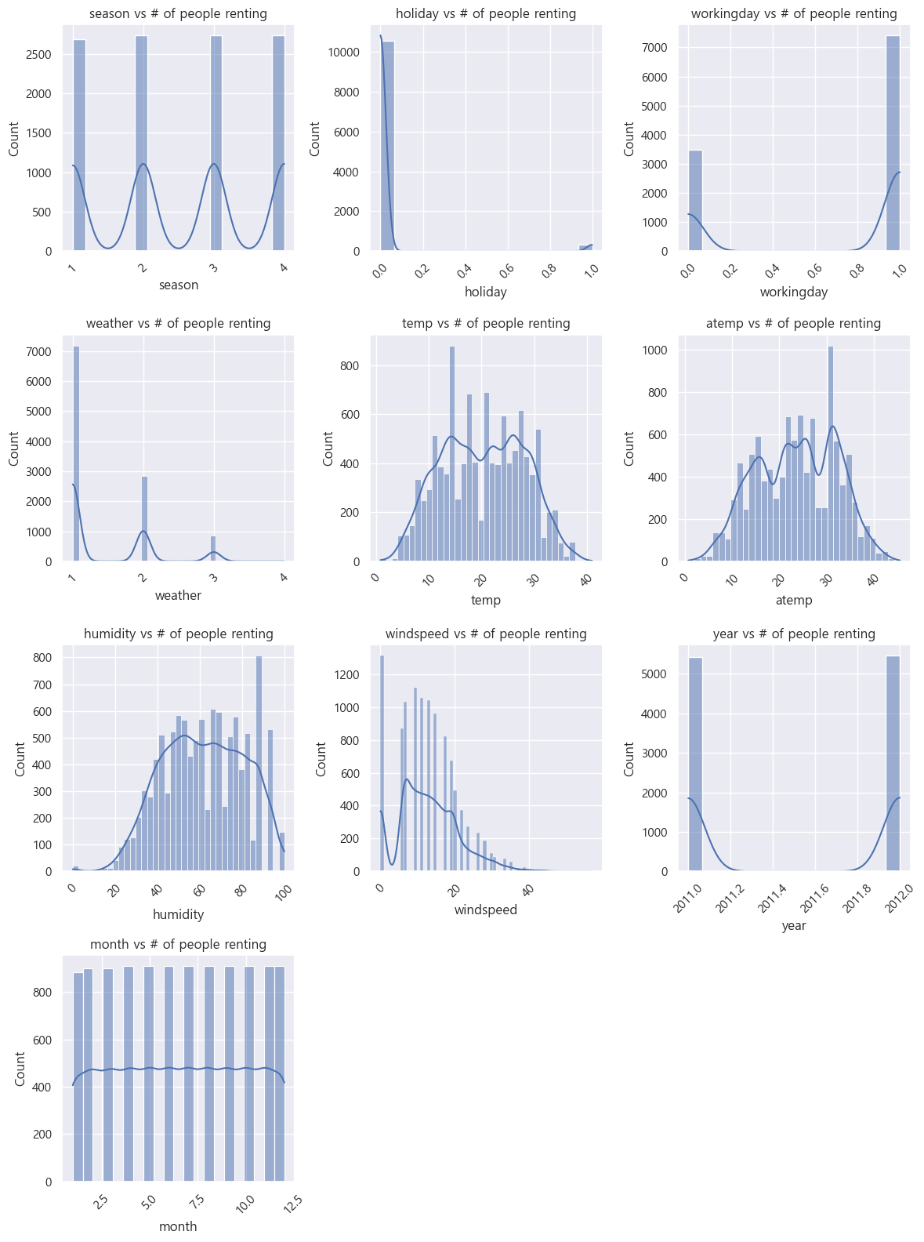


Slide 8
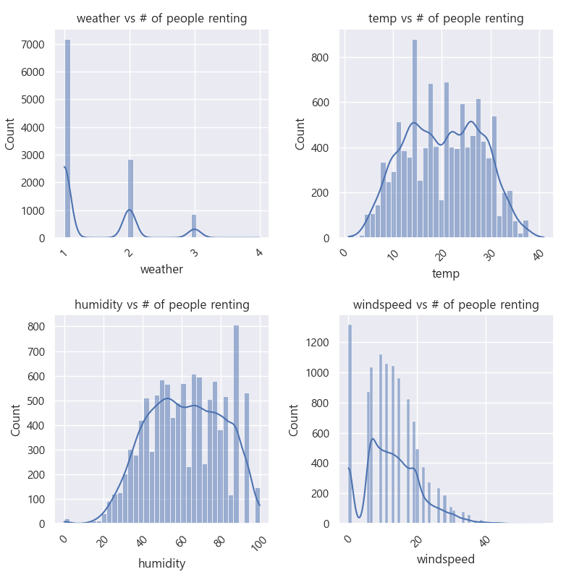
People rent bike usually when the weather is good!

Slide 9
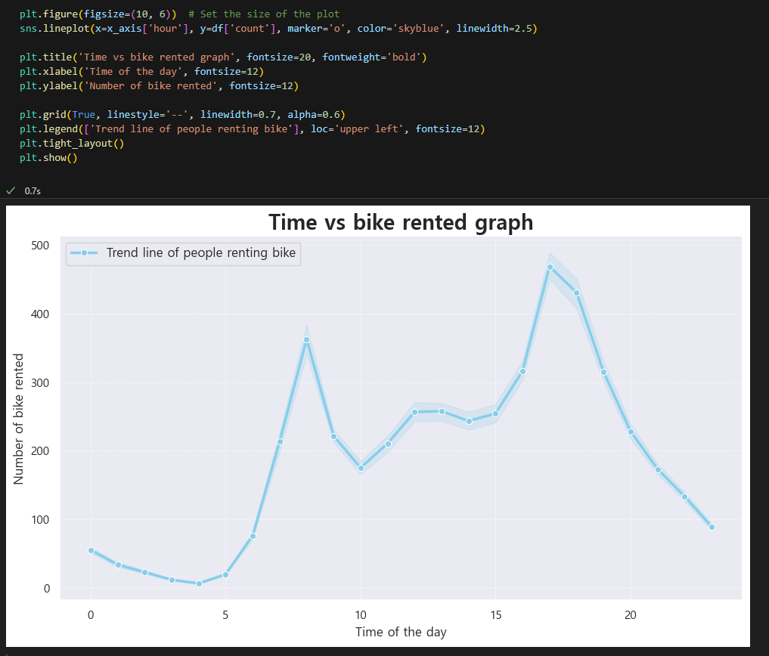

Slide 10

Ideas
01
Weather
Good weather leads to more bike rentals.
Optimal temperature for bike rentals is between 15 to 25°C (cool, not too cold or hot).
Humidity and wind are proportional to the number of bike rentals, with moderate levels being favorable.
02
Time
People tended to rent bikes more around commuting hours (morning and evening).

Slide 11
Step 3: Data Analysis

Slide 12
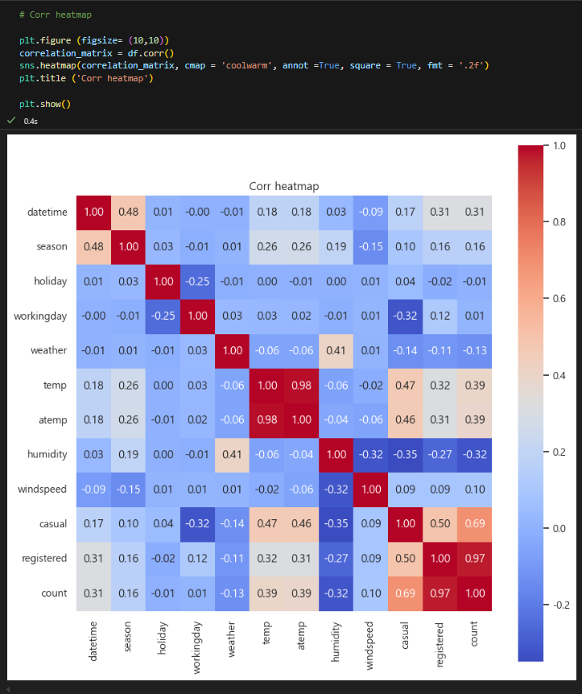

Slide 13



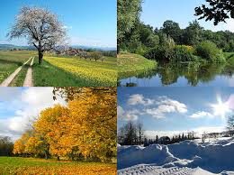
Temp & Non-member users:
Correlation: +0.47
As the temperature rises, the number of non-member users increases.
Humidity & Non-member users:
Correlation: -0.35
As humidity decreases, the number of non-member users increases.
Weekend & Non-member and members:
Correlation: -0.32, but members: 0.12
Non-members visit more on weekdays!
Members visit more on weekdays regardless of the weekend!
Additional fact:
Both season and wind speed have a positive correlation with bike rental counts, meaning they increase in proportion with the number of rentals.

Slide 14
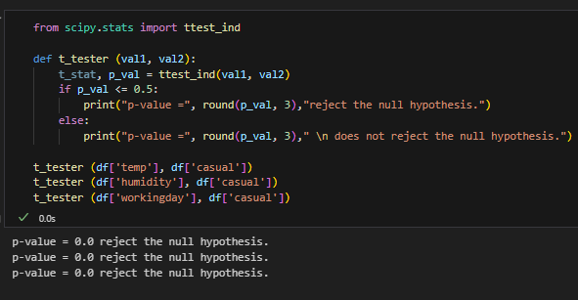
T-test
A correlation value of 0.3 indicates a weak correlation, meaning that a t-test would show only a very slight relationship.
This was also proven through t-test. Indeed, temperature, working day, and humidity had significant correlation.

Slide 15
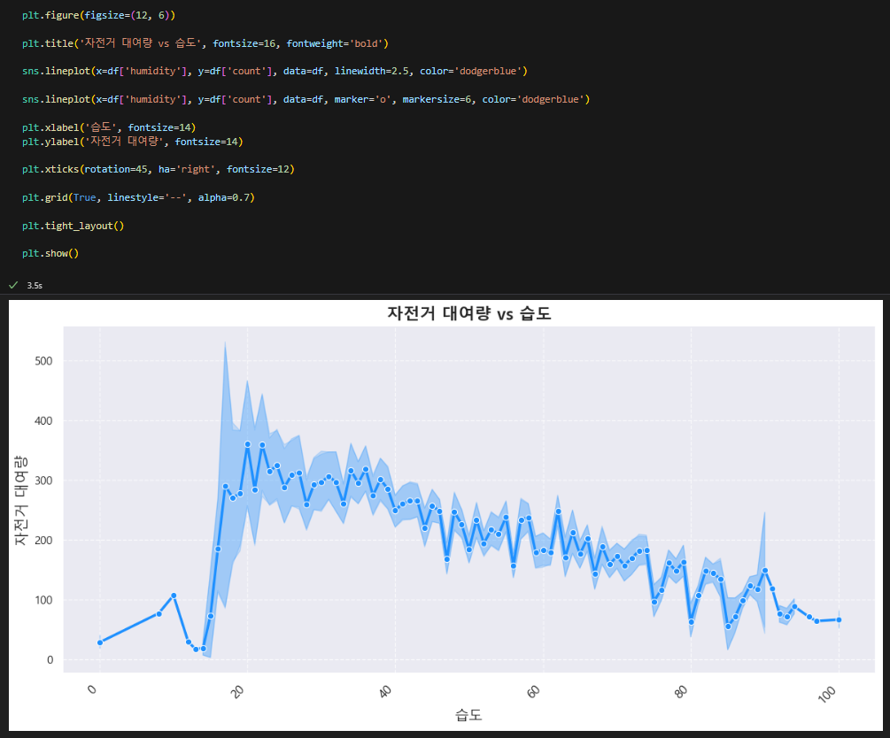
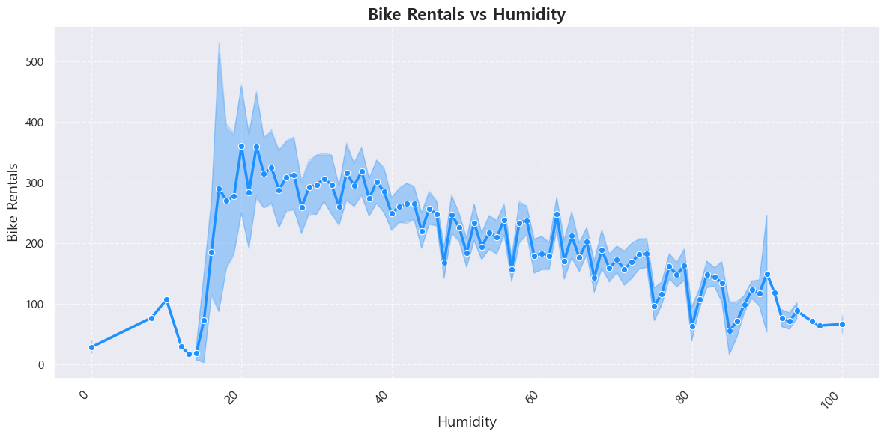
Visual Example of Rental vs Humidity
There is a clear trend that the larger the humidity, the lower the bike rental.

Slide 16
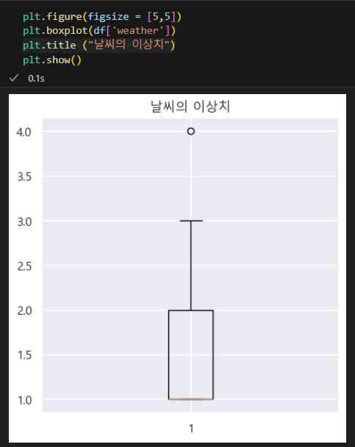
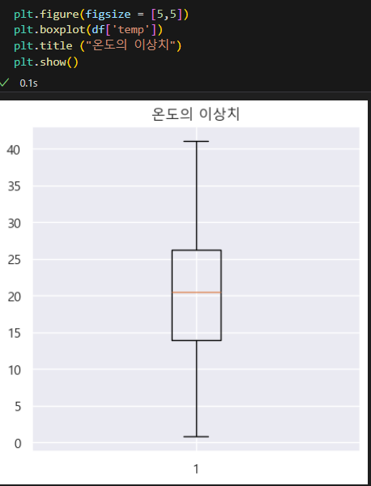
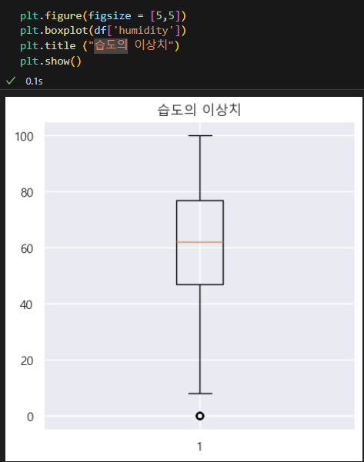
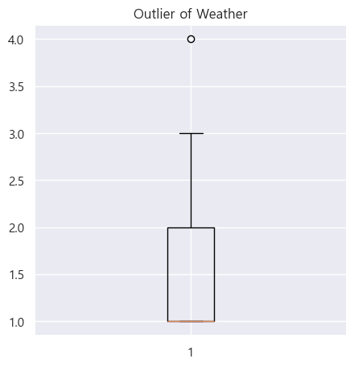
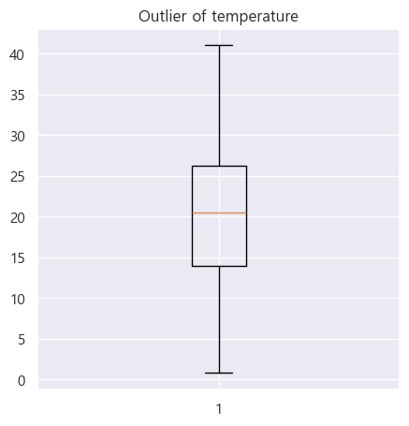
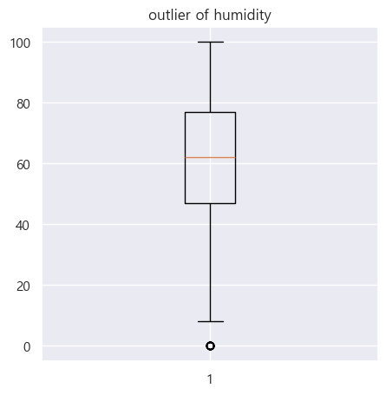
Problem with the dataset
The cluster shapes are not close to spherical (circular).
There are outliers.
Therefore, clustering is very challenging.
Risk of overfitting.
Presence of outliers.
There are many other interpretations, and trees are not ideal due to these.
Trees can lead to memory issues when the size increases.

Slide 17

Step 3:
ML

Slide 18
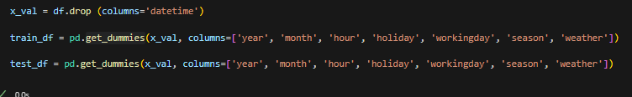
Before ML!
Issue: The 'Year' feature is in numeric format, causing excessively large regression coefficients.
Cause: The large year values lead the model to overly emphasize them.
Solution: Apply one-hot encoding using get_dummies() method.
Applicable Features: year, month, day, hour, holiday, workingday, season, weather columns.
Goal: Improve prediction performance.

Slide 19
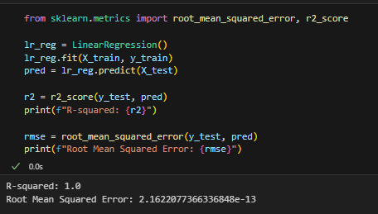
Result: Mistake?
Overfit??? How can we prevent this?

Slide 20
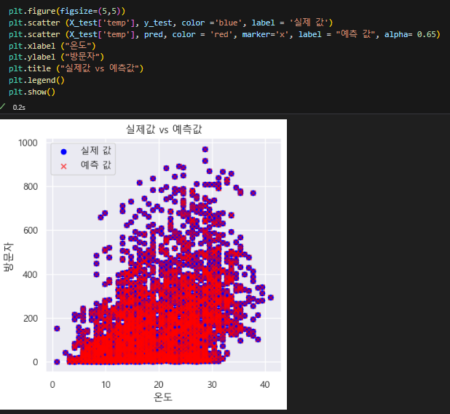
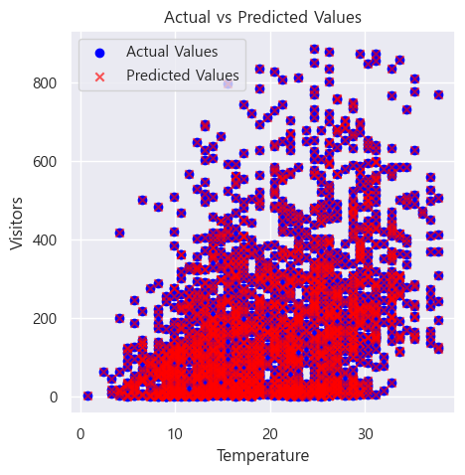
Warning: Overfit
Reason for not using trees: Even a small mistake in tree models can lead to significant issues.
What’s the problem?
The issue is the lack of regularization and cross-validation, specifically the absence of a Ridge (L2) model, which resulted in overfitting.
내

Slide 21
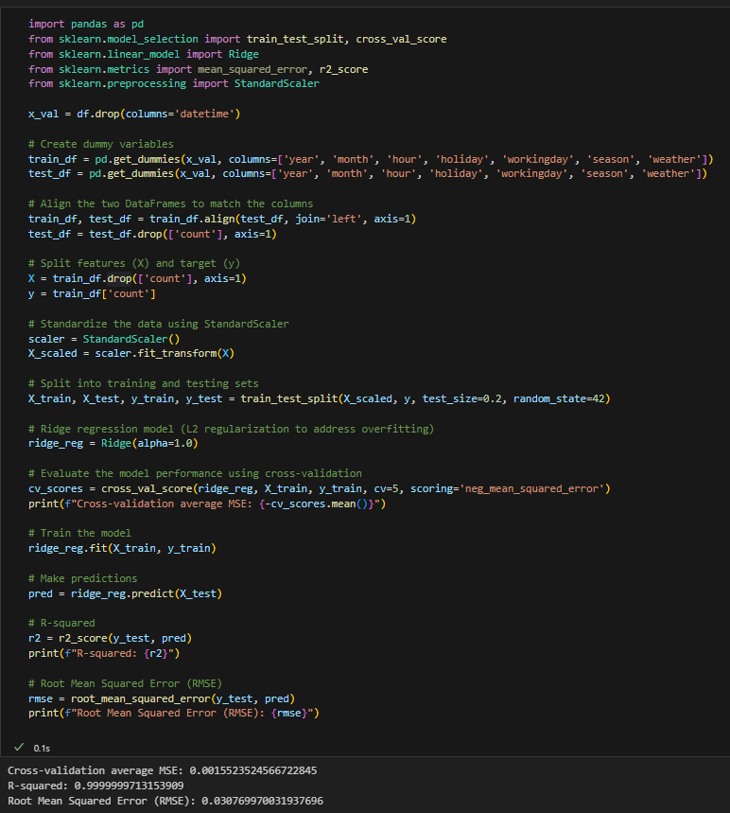
As seen from the cross-validation mean, R², and RMSE, normalization has been applied.
For cross validation, cross_val was used.
Trees could have been used for data analysis; however, they would have likely needed more cross validation and removal of outliers in data.

Slide 22

Additional Ideas and Conclusion
A.
B.
Temp/Weather
Suggestion
Additional graph
Suggestion for bike companies

Slide 23
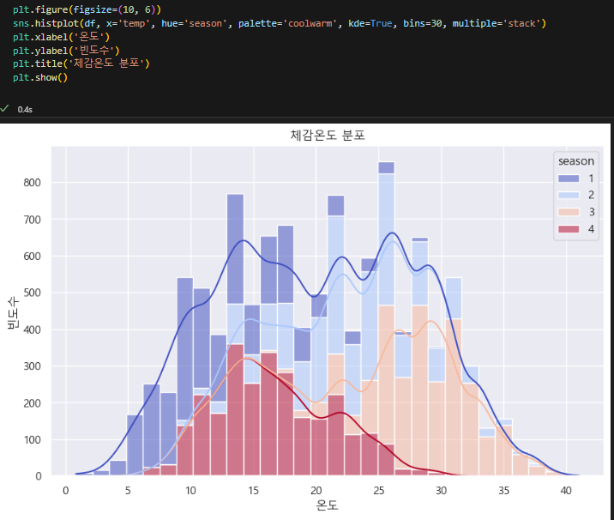
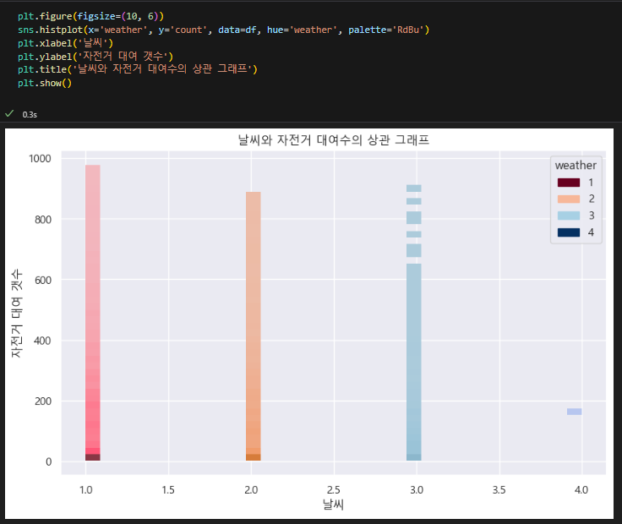
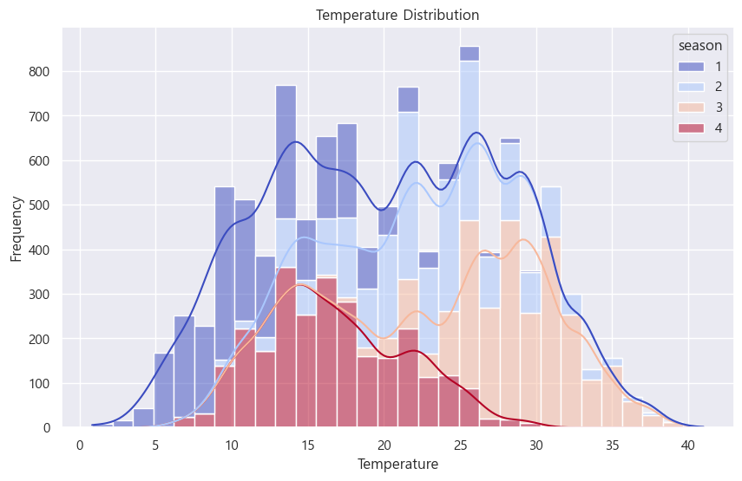
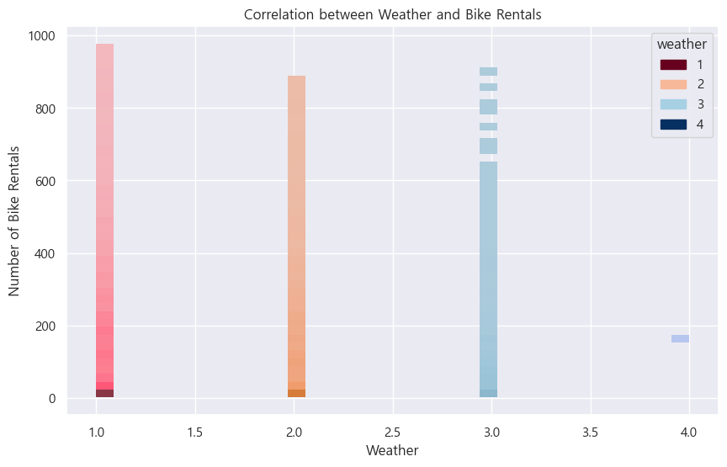
Additional Graphs!

Slide 24



Recommendation
Focus on commuting hours!
Weekdays 7 to10, 17 to 19: target = members
Increase # of promotion during this time for these targeted audience
Weekend or weekdays afternoon promotion
Focus marketing during 12 to 17 for both member and non-members
Low temperature during winter: Seasonal discount -> increase users.
Bring more bike users with promotion as low temperature causes decrease of bike use
Eg: Christmas family discount campaign!

Slide 25
Thank you

